Slide 1
1 – D Oil simulator using Black oil model
By Salil Pradhan
Rajnish Kumar Singh
Praveen Kumar Yadav
Sankar Dangi

Slide 2
What is Reservoir Simulator ?
A mathematical model that imitates the Reservoir .
A computer model that is used to predict the flow of fluids behavior .

Slide 3
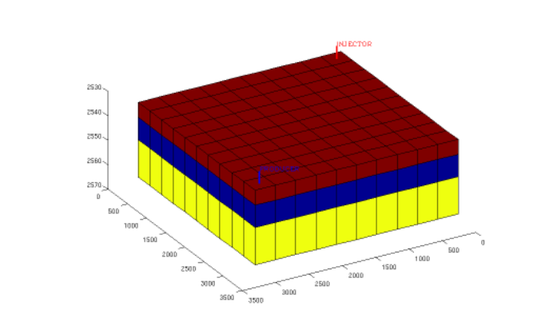
Modelling Reservoir Simulator
Objective of Reservoir Simulation
How pressure varies in various grid block with production or injection.
Variation of Relative Gas and oil permeability with various saturation.
Variation of Oil formation volume factor.
Variation of Gas solubility and Finally Transmissibility of each grid block.

Slide 4
Types of Reservoir Simulator
Black Oil Simulator
Compositional Oil Simulator
Oil is treated as single phase
No interaction between gas or water phase
Fluid Properties is function of pressure and bubble point pressure
Interaction between various hydrocarbon phases are consider.
Fluid Properties to be dependent on fluid compositional.

Slide 5
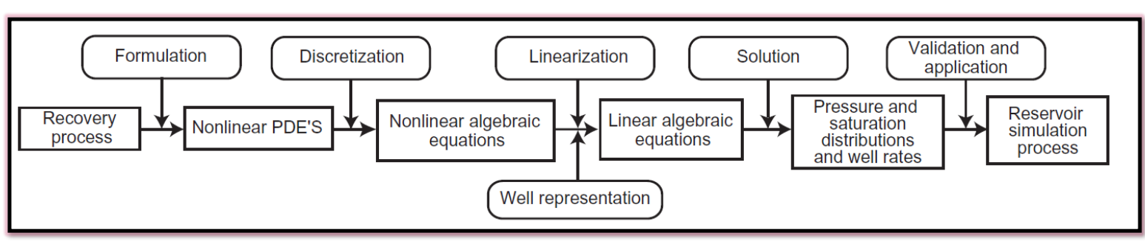
How to formulate the Equation for Reservoir Simulator

Slide 6
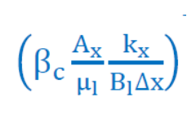
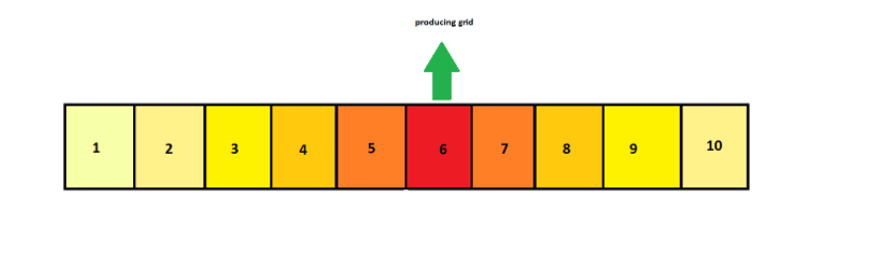
Equations used for calculations
Transmissibility
Pressure In grids

Slide 7
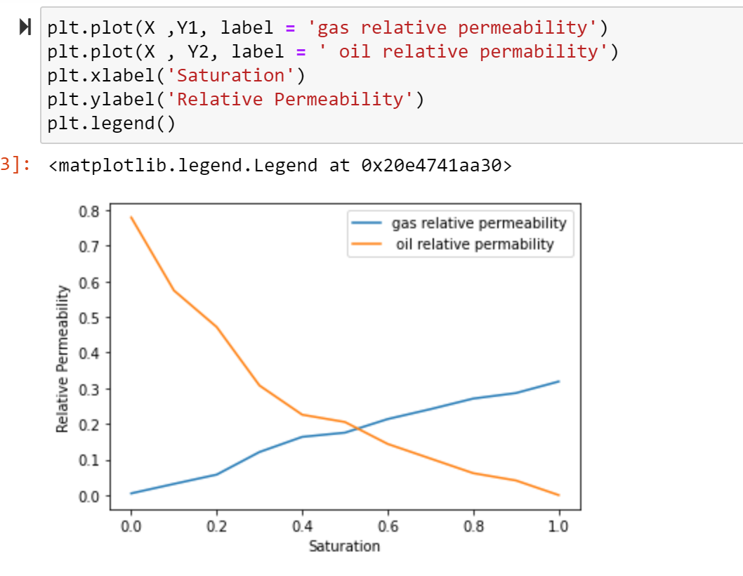
Relative Permeability variation with Saturation

Slide 8
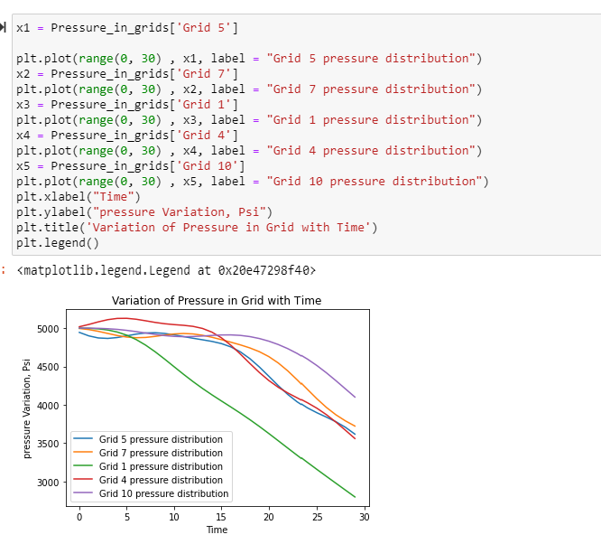
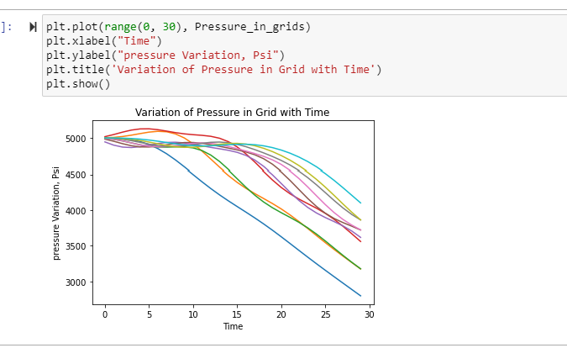
Pressure Variation in Grid Block in Time

Slide 9
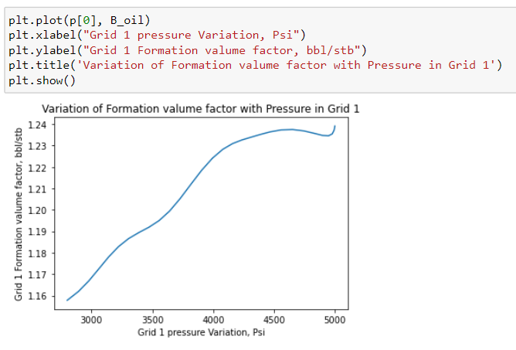
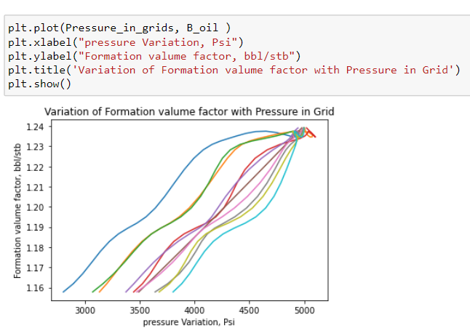
Oil formation volume variation with Pressure in Grid Block

Slide 10
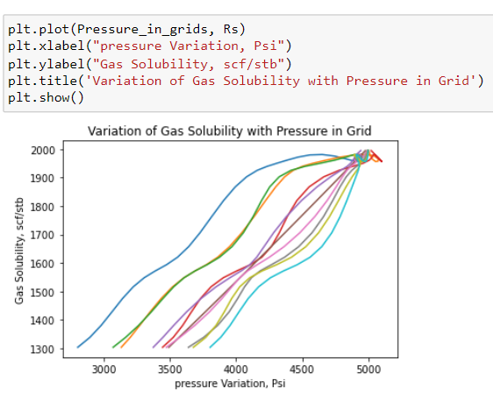
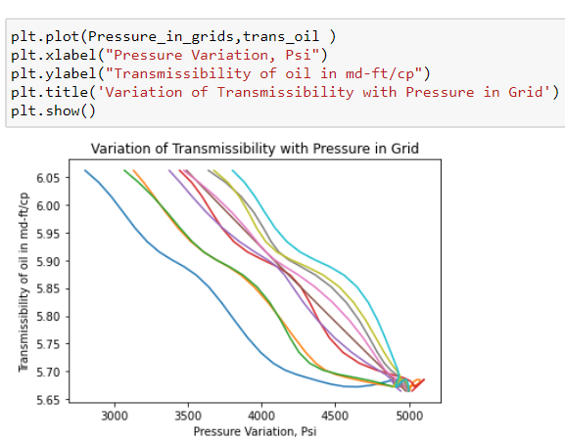
Gas solubility and Transmissibility variation with Pressure in Grid Block

Slide 11
Conclusion
Assuming below bubble point the formation volume factor and Gas solubility both decreases with pressure.
With increase in pressure the Transmissibility value increases.
While producing the pressure decreases rapidly in the producing grid block 5 as well as the grid block 1 which is surround by a no flow boundary.

Slide 12
Thank You

